Slide 1
A Selection of ebay Low Cost Merchandise
CISC3014 final project
Li Shitian
DC126892
Chen Yu
BC104414

Slide 2
catalogue
Our original intention
Why we choose eBay
The architecture of the program
Code Reference
Sample
Future application scenario
Conclusion of our project

Slide 3
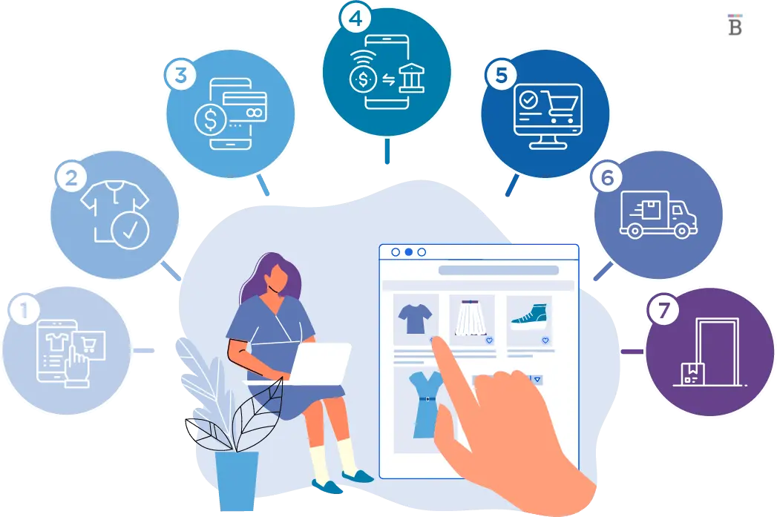



Our original intention
With the popularity of e-commerce shopping, the main consumer behavior in modern society has gradually shifted from offline to online. E-commerce platforms bring together detailed attributes and information of different products from all over the world, from various brands, on consumers' cell phones or computer terminals. The biggest challenge for consumers is to find their desired data from the huge amount of information and compare them to make the best choice. Facing such a complex and time-consuming task, we have made a simpler and easier-to-use version of ebay's search recommendation system based on what we have learned in CISC3014 this semester ......

Slide 4


Why we choose eBay?
eBay is one of the world's pre-eminent online marketplaces today, offering a wide range of products. eBay supports a variety of transactions, including auction-style and fixed-price sales. In addition it supports a variety of transactions, including auction-style sales and fixed-price sales. As a result, eBay's large inventory and varied buying and selling strategies create a dynamic environment where prices can fluctuate dramatically, providing value-conscious consumers with an excellent opportunity to make significant savings on consumer products.

Slide 5
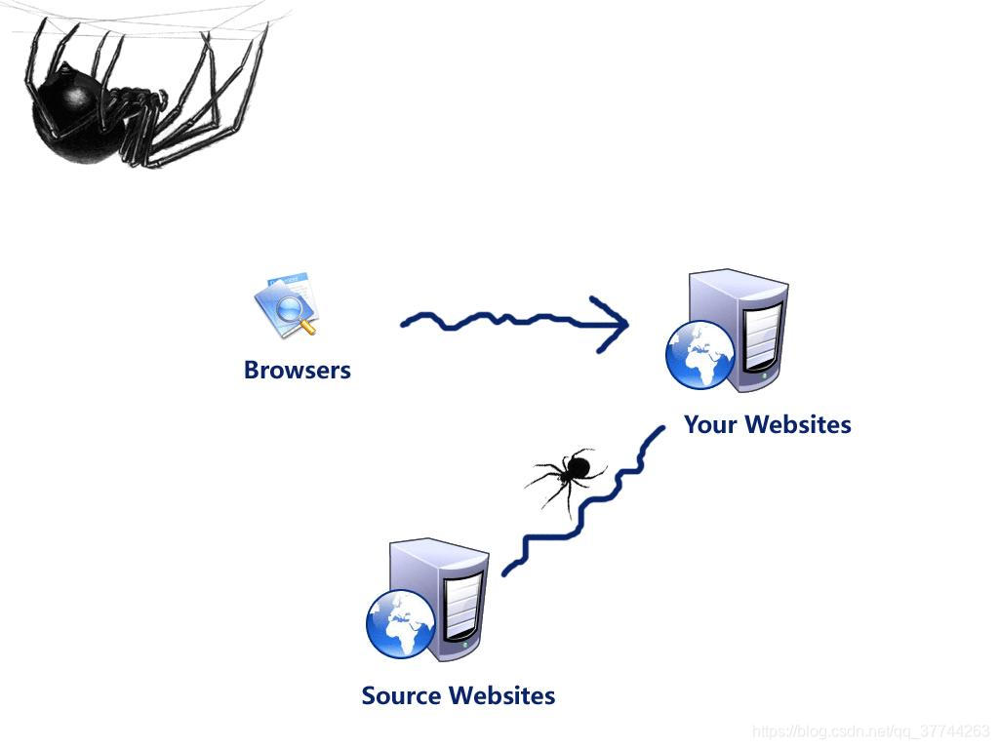

The architecture of the program
Spider_1: Grab the lowest priced item on the page after entering the keyword
Enter two brands’ name in program
Compare the price
Output the name with lowest price
Spider_1: Grab the lowest priced item on the page after entering the keyword

Slide 6
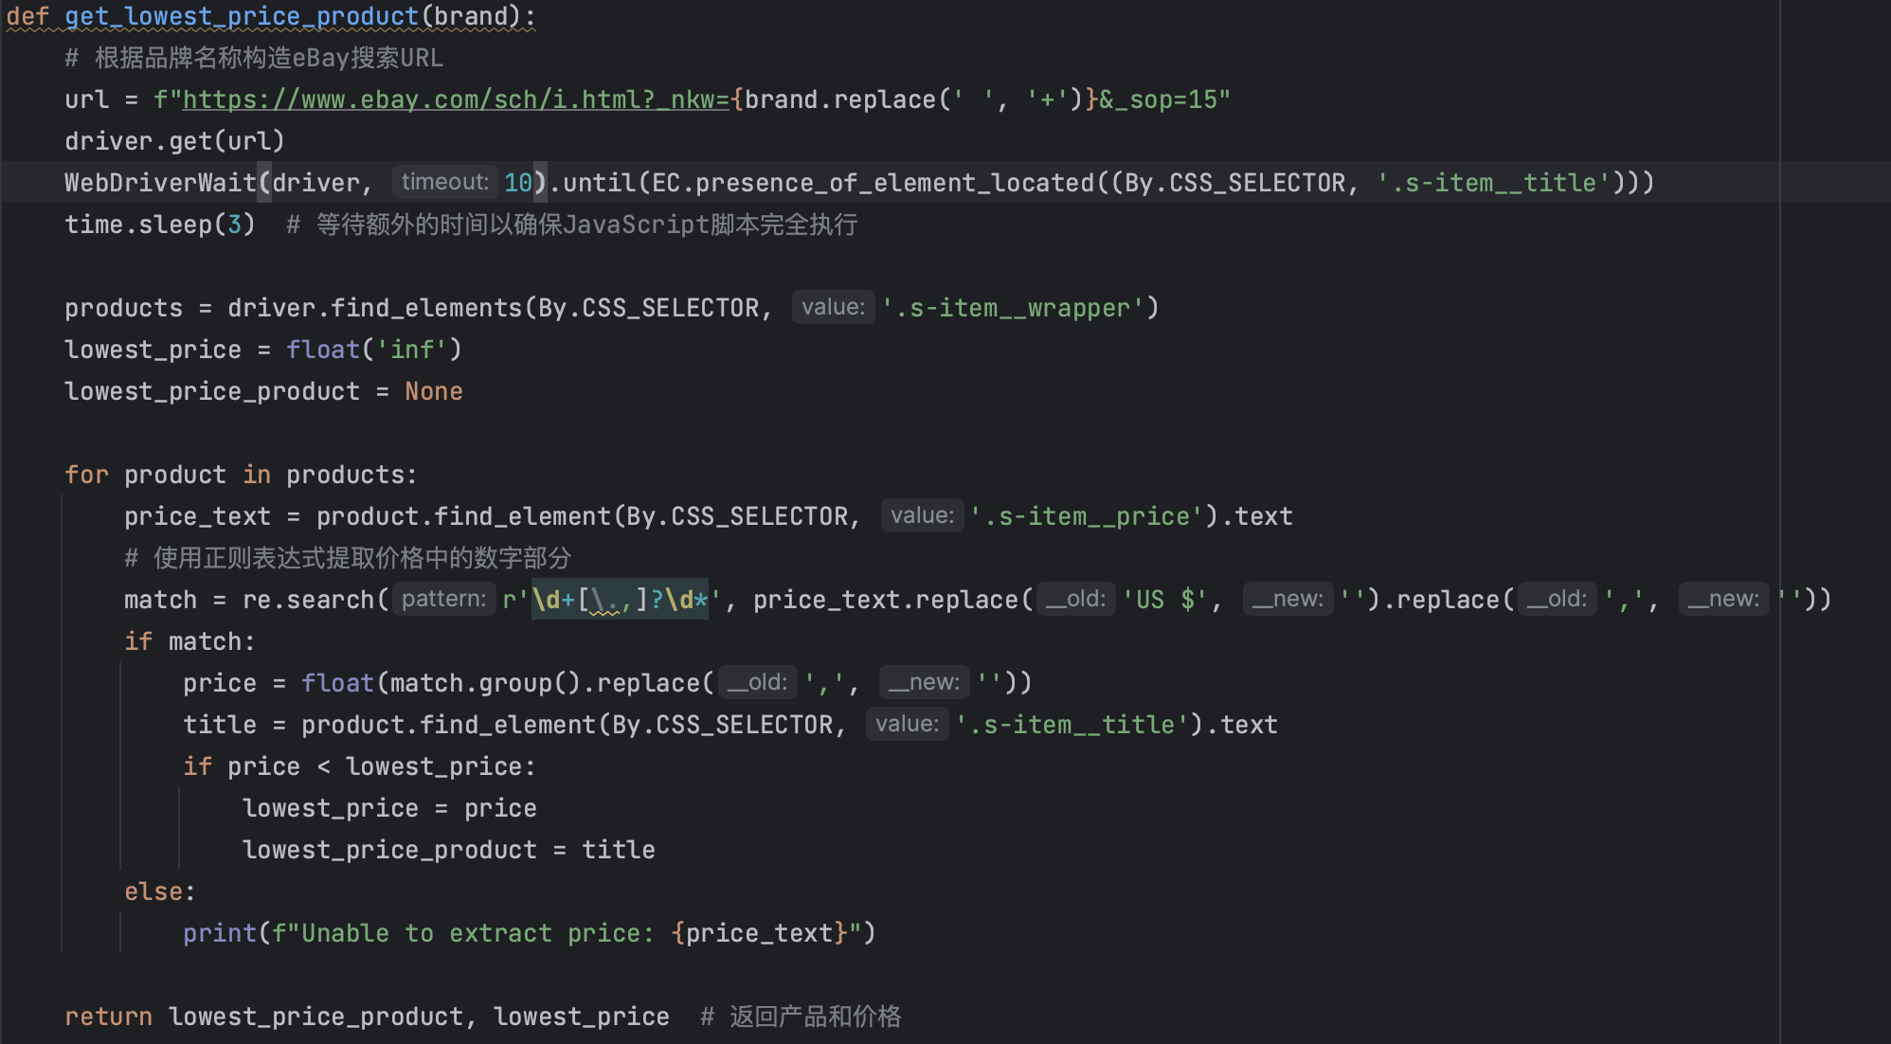
Code reference
Search Initialization
Page Waiting Mechanism
Data extraction process
Price processing logic
Result Output
Notes:
1. **搜索初始化**
- 接收品牌名称作为参数
- 构建eBay搜索URL，自动将品牌名称编码到URL中
- 使用WebDriver访问搜索结果页面
2. **页面等待机制**
- 设置10秒等待时间确保页面加载
- 专门等待商品标题元素出现
- 额外3秒缓冲时间确保JavaScript完全执行
3. **数据提取流程**
- 定位所有商品元素
- 初始化最低价格为无穷大
- 遍历所有商品信息
4. **价格处理逻辑**
- 使用正则表达式提取价格数字
- 清理价格文本（去除货币符号和分隔符）
- 转换为浮点数进行比较
5. **结果输出**
- 返回最低价格商品的标题和价格
- 如遇价格提取异常会打印提示信息

Slide 7
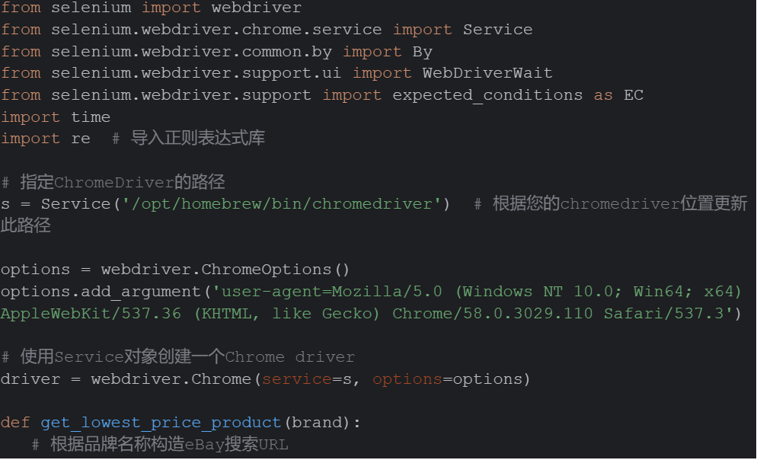
Code reference
Core Dependency Import
Chrome Driver Configuration
Browser Options Settings
WebDriver Instantiation
Notes:
1. **核心依赖导入**
- 引入Selenium WebDriver核心组件
- 导入Chrome浏览器驱动服务
- 配置元素定位和等待机制的必要模块
- 导入正则表达式库用于数据处理
2. **Chrome驱动配置**
- 指定ChromeDriver的安装路径
- 该示例使用homebrew安装路径'/opt/homebrew/bin/chromedriver'
- 需根据实际安装位置调整路径
3. **浏览器选项设置**
- 初始化Chrome浏览器选项
- 配置User-Agent信息模拟真实浏览器环境
- 设定为Windows 10系统下的Chrome浏览器特征
4. **WebDriver实例化**
- 使用配置好的service和options创建Chrome WebDriver实例
- 这个driver实例将用于后续的页面操作和数据提取

Slide 8
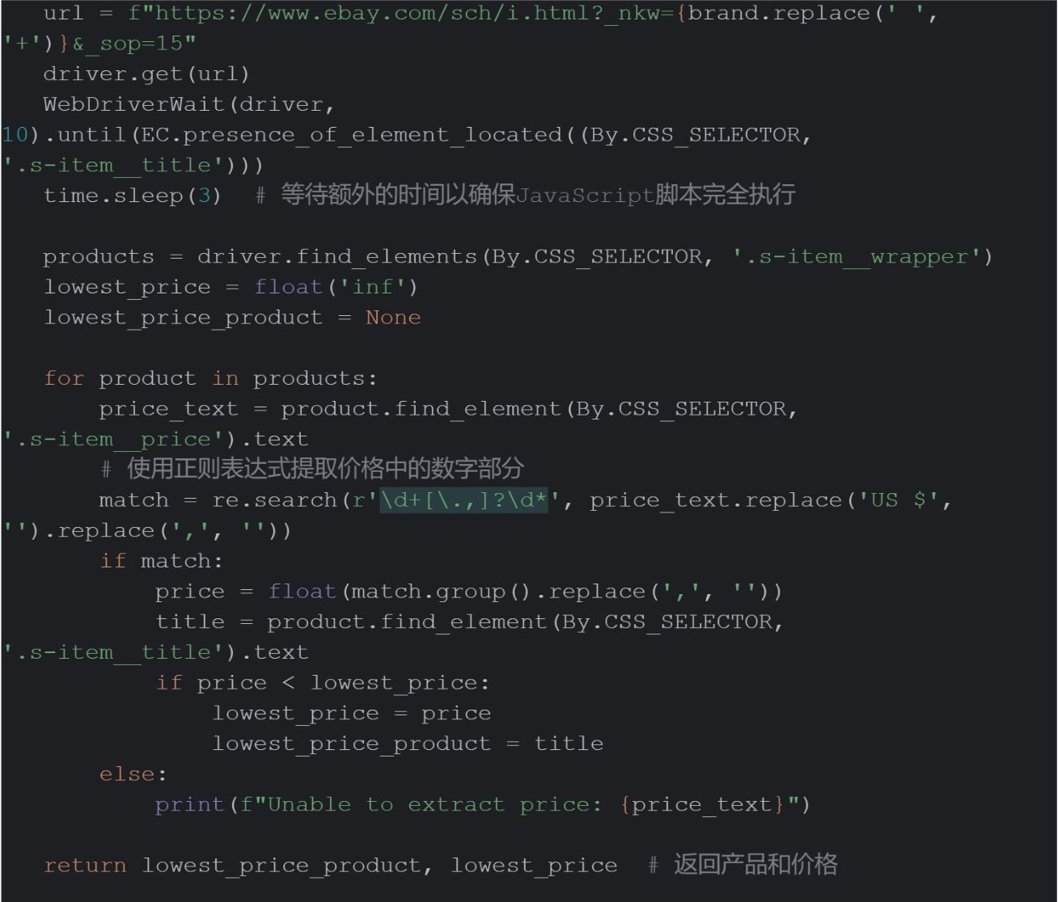
Code reference
URL construction and page access
Product data initialization
Price Data Processing
Minimum price comparison and storage
Returning results
Notes:
1. **URL构建与页面访问**
- 构建eBay搜索URL，将品牌名称作为搜索关键词
- 使用WebDriver访问目标页面
- 设置10秒智能等待时间，确保页面元素加载
- 额外3秒静态等待，确保JavaScript渲染完成
2. **商品数据初始化**
- 使用CSS选择器定位所有商品元素
- 设置初始最低价格为无穷大
- 初始化最低价格商品为空
3. **价格数据处理**
- 遍历所有商品元素
- 提取商品价格文本
- 使用正则表达式处理价格格式：
* 移除货币符号"US $"
* 清理价格中的分隔符
* 提取数字部分并转换为浮点数
4. **最低价格比较与存储**
- 比较当前商品价格与已知最低价格
- 更新最低价格和对应商品信息
- 遇到价格提取异常时输出提示信息
5. **结果返回**
- 返回找到的最低价格商品标题和价格
- 实现了完整的自动化搜索和数据提取流程

Slide 9
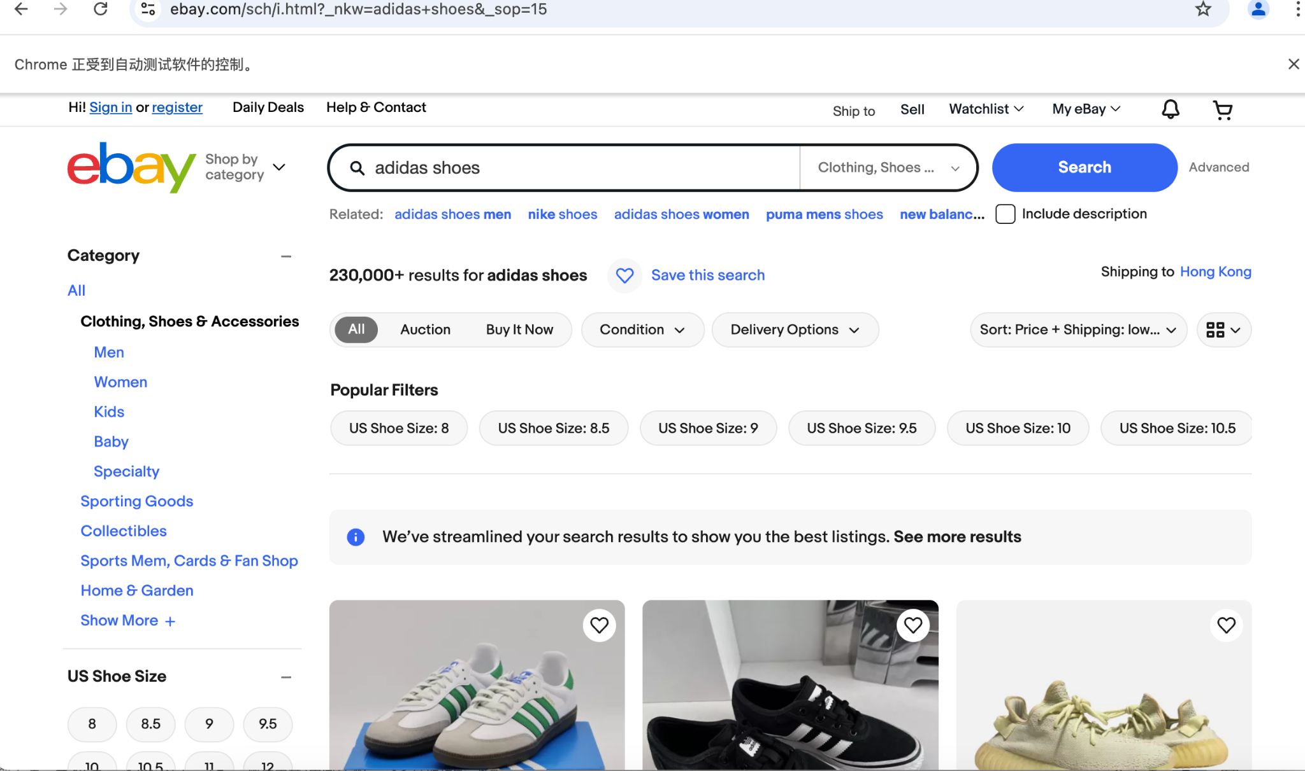
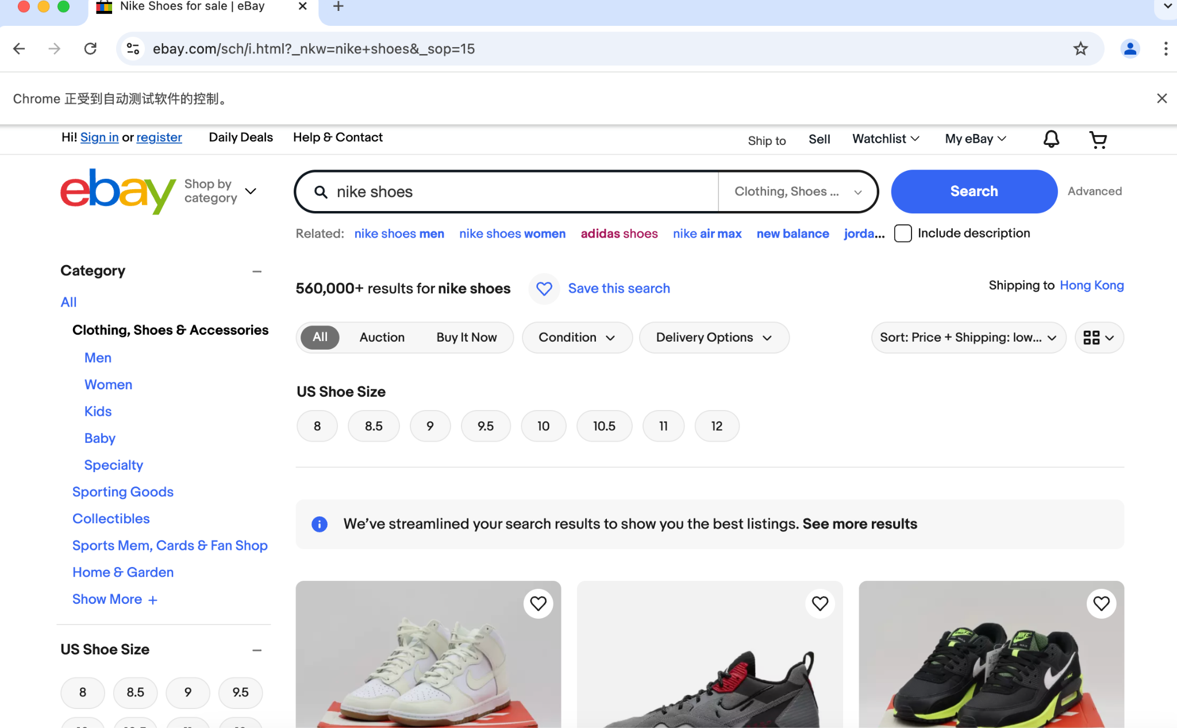
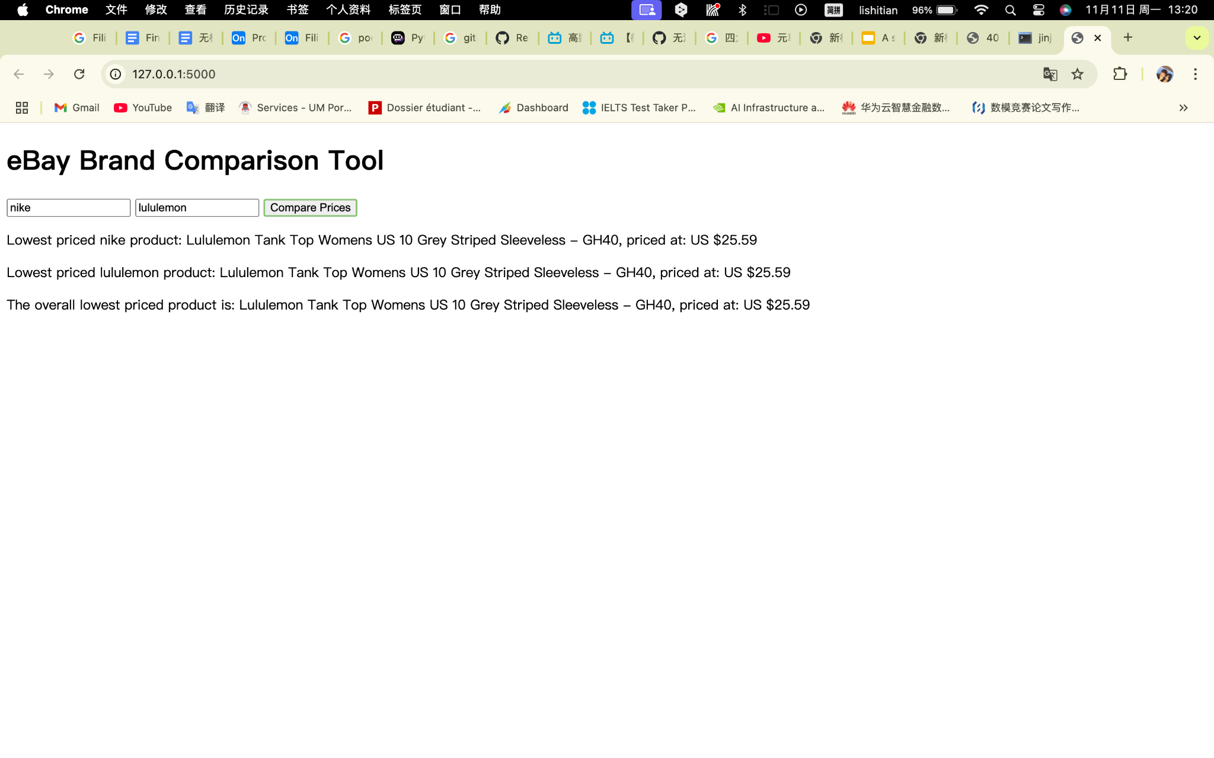
Sample
Enter the first brand name : nike shoes
Enter the first brand name : adidas shoes

Slide 10
Demo

Slide 11


Future application scenarios
We have developed this system as an extension and enhancement to the existing eBay Price Comparison tool, and in the future it could evolve into a more comprehensive e-commerce solution that not only simplifies the purchasing decision process for users (with integrated auto-buy functionality that allows users to set up auto-buy conditions, such as auto-purchase when price thresholds are reached), but also automates routine tasks and provides deeper data insights (such as the new and used status of items), shipping options, seller ratings and return policies. new and old status, shipping options, seller ratings and return policies as well as price trend analysis, predicting the best time to buy).

Slide 12


Conclusion of our project
In this project, we implemented a Python script and Selenium WebDriver automation to crawl and compare product prices by brand name from the eBay website. The script simulates the process of a user browsing a web page, being able to navigate to eBay's search function, extract product prices, and determine the lowest priced item for a given brand.
The script flexibly responds to different user queries and accurately compares prices. It also properly manages the opening and closing of browser sessions to ensure efficient use of computing resources and prevent memory leaks or resource hangs.
Through this study, we can see the potential of automation technology in processing and analyzing complex data, foreshadowing the key role automation tools will play in the future of data-driven decision-making.

